Slide 1
DEMONSTRATOR FHM#1:
Analysis of wind data

Slide 2
Contextualization/1
Data Analysis is often based on the online-aggregator ThingSpeak and MATLAB
This demonstrator will take you through a first simple data analysis example using data from an Arduino-based Weather Station
Data are collected and analysed by an MATLAB-based app running on a ThingSpeak online-aggregator

Slide 3
Contextualization/2
You will be able to
Understand the system design
Develop and understand the basic level analyses algorithm
Operate programming tools on an cloud based aggregator site
Learn how to extract collected data from a message stream
Program the analyses and the visualisation on aggregator site
Run the algorithm and interpret the results

Slide 4
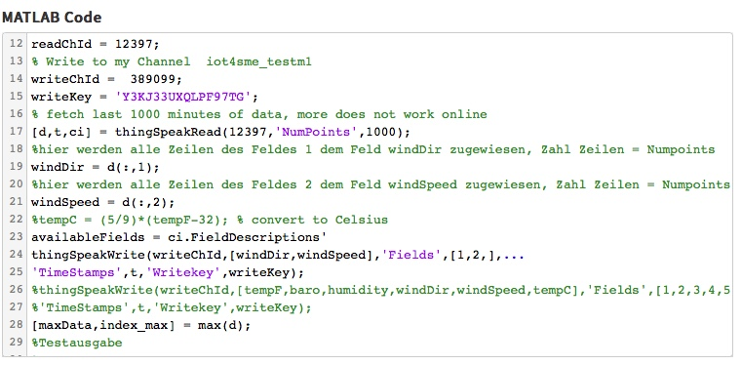
Orientation 1
With the next slide you will see the analysis algorithm
In order to start the simulation click here
In order to review/modify the programming of the app click here
Account: US:iot4smes@uninettunouniversity.net, PW: Orientation1
In order to re-develop the analysis app setup your own ThingSpeak account
Write your own MATLAB-code into the editor box and run

Slide 5
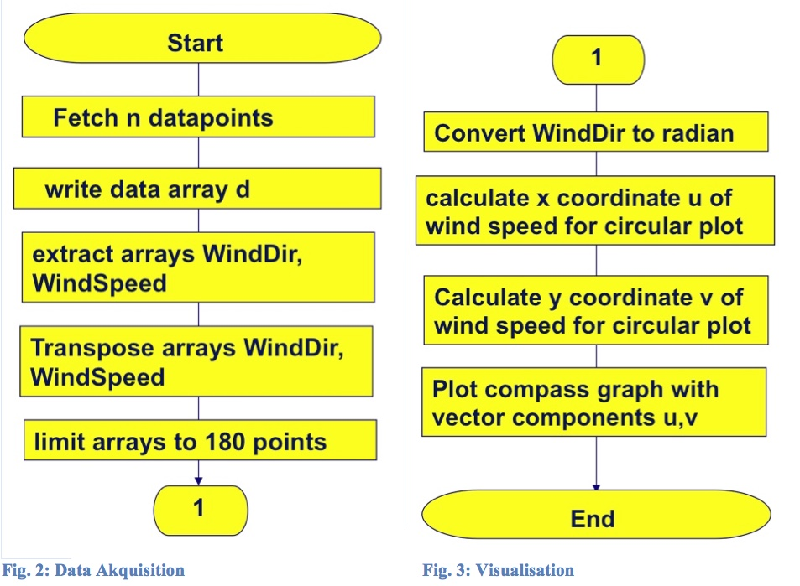
Orientation 2
The analysis algorithm
(basic level)

Slide 6
Experimentation
Practice1
Run the simulation of wind direction analysis
Practice 3
Free practice
Code any analysis algorihm you want
Practice 2
Modify/ test the existing MATLAB programming
Write your own MATLAB-code for of wind direction analysis

Slide 7
conclusions
You have been able to understand and experiment with the wind direction analysis algorithm
Reading data from an Arduino-based Weather Station
Analysing data
Writing compass graph
code your own ThingSpeak/MATLAB programs

Slide 8
Erasmus+ Strategic Partnership nº 2016-1-IT01-KA202-005561

